Slide 1
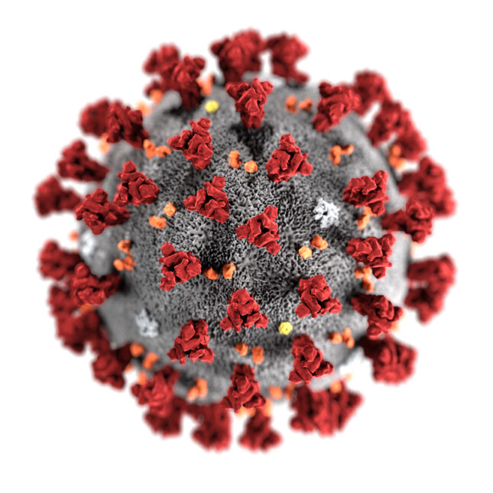

Effects of Vaccines on COVID-19 in Illinois DuPage, County
Name: Sindhu Madhadi

Slide 2
Introduction
This project focuses on understanding the importance of Vaccine in Covid-19 pandemic on the Illinois, DuPage County.
I have used the data from CDC Vaccine Data for the period December 13, 2020 through November 09, 2021.
The questions I tried to answer in this project are, How significant is the data? Does Vaccination decrease the count of confirmed covid cases?
I aim to answer our questions and quantify the impact of Vaccine on Covid Cases in DuPage County by applying a combination of Visualization graphs and predictive Testing (Multiple linear regression) to this dataset.

Slide 3
Data Profile
The data collected in the CDC Vaccine Data provides insight on of vaccine in Covid-19 for different age groups across different county in US. I have filtered out the data for the Illinois DuPage County from the given dataset .
The data set is large and has 32 columns and 1.09M rows. The Columns used in this analysis for visualizations are:
Date
Recip_State(state Name)
Recip_County
Series_Complete_pop_Pct(totoal population percentage)
Series_Complete_18PlusPop_pct
Series_Complete_65PlusPop_Pct
Series_Complete_12PlusPop_Pct
The data is merged with the IiIllinois (Dupage)Data set from A4 Analysis and stored in the following CSV files
Dupgae_Vaccines_merged_data.csv
Dupgae_Vaccines_cleaned_data.csv

Slide 4
Caveats
Few missing data points in the data are the current data set is from 12/13/2020 to 11/09/2021, our A4 common analysis is from February 1, 2020, through October 15, 2021.
So there is a gap in the period, I couldn’t find a dataset exactly matching this period.

Slide 5
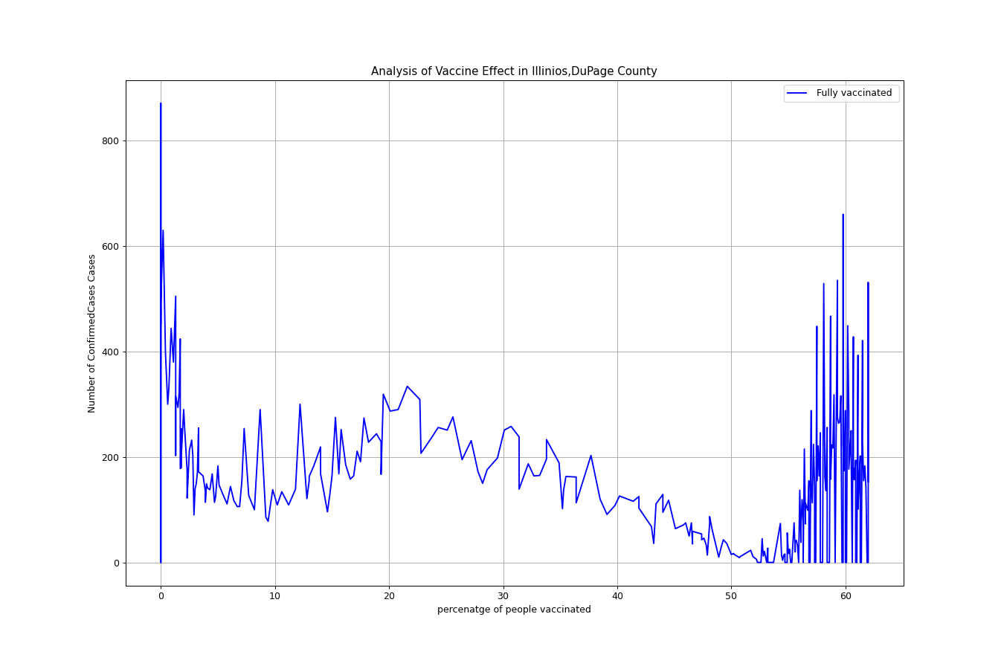

Analysis:
After Merging the two data sets ie Illinois DuPage Data and Covid Vaccines data based on date .
I plotted graphs for the Total number of confirmed cases vs total number of people vaccinated fully.
To find out the impact of Covid Vaccine on the Cases Count.
Notes:
Average score for each state. Oregon is the worst.

Slide 6
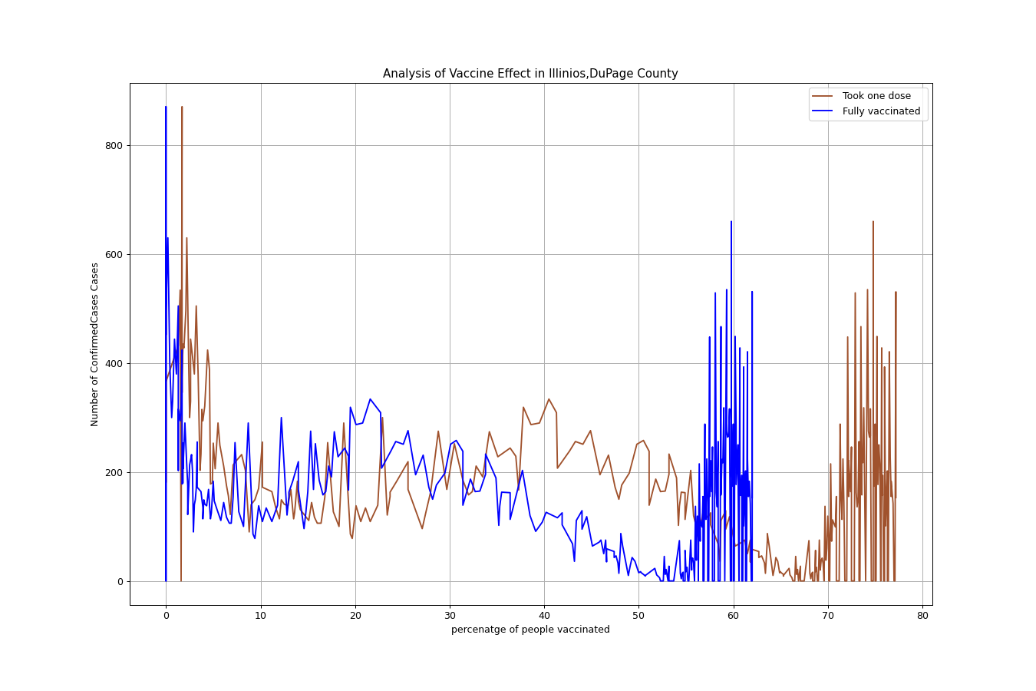
Further Analysis:
Check the trends in Confirmed Cases count with both fully vaccinated People an people with one dose.

Slide 7
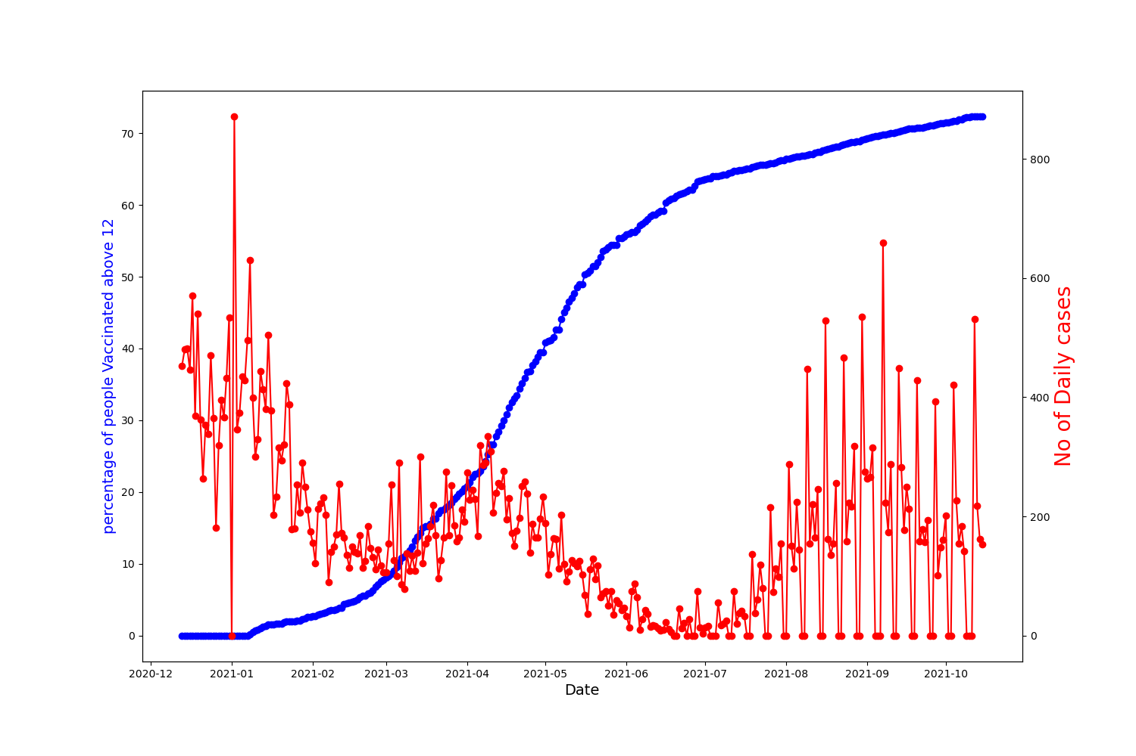

Trends: Based on Age Group
Age Group 12Plus who are fully Vaccinated

Slide 8

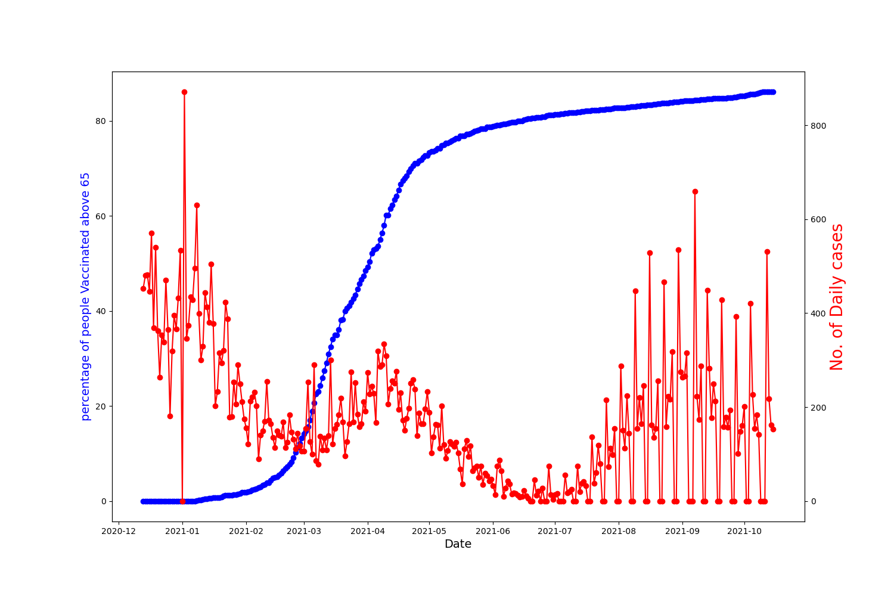

Slide 9
Regression Analysis:
We wanted to check the correlation of different age group people vaccinated in our dataset, and their impact on the increase in Covid cases. We selected these 3 variables in the dataset for our analysis and checked whether they are statistically significant:
Series_Complete_18PlusPop_pct
Series_Complete_65PlusPop_Pct
Series_Complete_12PlusPop_Pct

Slide 10
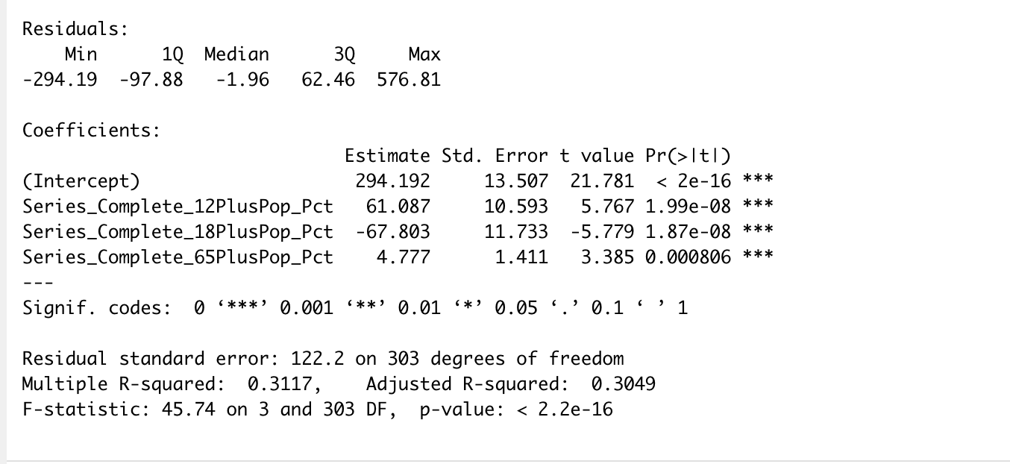
Predictive Testing
Method: Multiple Linear Regression
Call : lm(formula = DailyCases ~ Series_Complete_12PlusPop_Pct + Series_Complete_18PlusPop_Pct + Series_Complete_65PlusPop_Pct, data = data)

Slide 11
Regression Results:
Based on p-values, if p-value is less than alpha (0.05), then the variable is statistically significant.
So from the model all the variables which are statistically significant. Changes in these variables result in the change of Cases Count.
Based on the coefficients sign, we get whether it has a positive or negative correlation between the variables and the Cases Count.

Slide 12
Conclusions:
From the graphs and regression it is evident that with increase in no of people taking vaccine there is a decrease in the cases count in DuPage County
Also, from the regression we found that the data is statistically significant.
Disclaimer: Any statements/views referenced in this presentation are those of individuals opinion and not intended to malign any person, organization or anything.

